Slide 1

Ruby on Rails
Presentation to Agile Atlanta Group
Originally presented May 10 ‘05
Obie Fernandez
Agile Atlanta Founder /
ThoughtWorks Technologist
Notes:
<rdf:RDF xmlns="http://web.resource.org/cc/"
xmlns:dc="http://purl.org/dc/elements/1.1/"
xmlns:rdf="http://www.w3.org/1999/02/22-rdf-syntax-ns#">
<Work rdf:about="">
<dc:title>Ruby on Rails</dc:title>
<dc:date>2005</dc:date>
<dc:description>Powerpoint Presentation: Introduction to Ruby and Ruby on Rails given to the Agile Atlanta user group on 5/10/2005
</dc:description>
<dc:creator><Agent>
<dc:title>Obed Fernandez</dc:title>
</Agent></dc:creator>
<dc:rights><Agent>
<dc:title>Obed Fernandez</dc:title>
</Agent></dc:rights>
<license rdf:resource="http://creativecommons.org/licenses/by-sa/2.0/" />
</Work>
<License rdf:about="http://creativecommons.org/licenses/by-sa/2.0/">
<permits rdf:resource="http://web.resource.org/cc/Reproduction" />
<permits rdf:resource="http://web.resource.org/cc/Distribution" />
<requires rdf:resource="http://web.resource.org/cc/Notice" />
<requires rdf:resource="http://web.resource.org/cc/Attribution" />
<permits rdf:resource="http://web.resource.org/cc/DerivativeWorks" />
<requires rdf:resource="http://web.resource.org/cc/ShareAlike" />
</License>
</rdf:RDF>

Slide 2
Introduction
Why present Ruby on Rails to Agile Atlanta?
  Ruby is an agile language
  Ruby on Rails is Ruby’s Killer App
  Ruby on Rails promotes agile practices

Slide 3
Presentation Agenda
Brief overview of Ruby
Rails Demonstration
Description of Rails framework
Questions and Answers

Slide 4
Why Ruby?
Write more understandable code in less lines
Free (Very open license)
Extensible

Slide 5
Principles of Ruby
Japanese Design Aesthetics Shine Through
Focus on human factors
Principle of Least Surprise
Principle of Succinctness
Relevant because these principles were followed closely by the designer of Rails, David H. Hansson
  Scandinavian Design Aesthetic

Slide 6
The Principle of Least Surprise
This principle is the supreme design goal of Ruby
Makes programmers happy and makes Ruby easy to learn
Examples
What class is an object?
o.class
Is it Array#size or Array#length?
same method – they’re aliased
What are the differences between arrays?
diff = ary1 – ary2
union = ary1 + ary2

Slide 7
Principle of Succinctness
A.K.A. Principle of Least Effort
We don’t like to waste time
  Especially on XML config files, getters, setters, etc…
The quicker we program, the more we accomplish
  Sounds reasonable enough, right?
Less code means less bugs

Slide 8
Ruby is Truly Object-Oriented
All classes derived from Object including Class (like Java) but there are no primitives (not like Java at all)
Ruby uses single-inheritance
Mixins give you the power of multiple inheritance
without the headaches
Modules allow addition of behaviors to a class
Reflection is built in along with lots of other highly dynamic metadata features
Things like ‘=‘ and ‘+’ that you might think are operators are actually methods (like Smalltalk)

Slide 9
Some Coding Conventions
Method Chaining
print array.uniq.sort.reverse
Method Names include ! and ?
ary.sort! (discuss bang if there is time)
Iterators and Blocks vs. Loops
files.each { |file| process(file) }
Case usage:
  Class names begin with a Capital letter
  Constants are ALL_CAPS
  Everything else - method call or a local variable
Under_score instead of camelCase

Slide 10
Dynamic Programming
Duck Typing
Based on signatures, not class inheritance
Dynamic Dispatch
A key concept of OOP: methods are actually messages that are sent to an object instance
Dynamic Behavior
  Reflection
  Scope Reopening (Kind of like AOP)
  Eval
  Breakpoint debugger

Slide 11
Enough About Ruby!
What about Ruby on Rails?

Slide 12

Rails in a Nutshell
Includes everything needed to create database-driven web applications according to the Model-View-Control pattern of separation.
Mostly written by David H. Hannson
Talented designer
Dream is to change the world
A 37signals.com principal – World class designers
Over 100 additional contributors to the Rails codebase in 9 months!

Slide 13
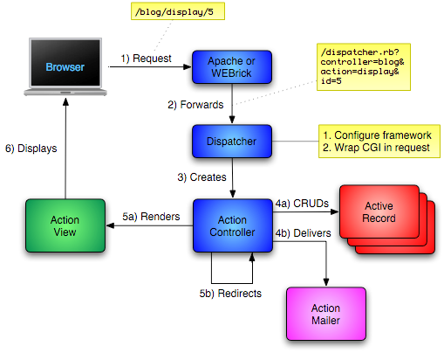
The Obligatory Architecture Slide

Slide 14
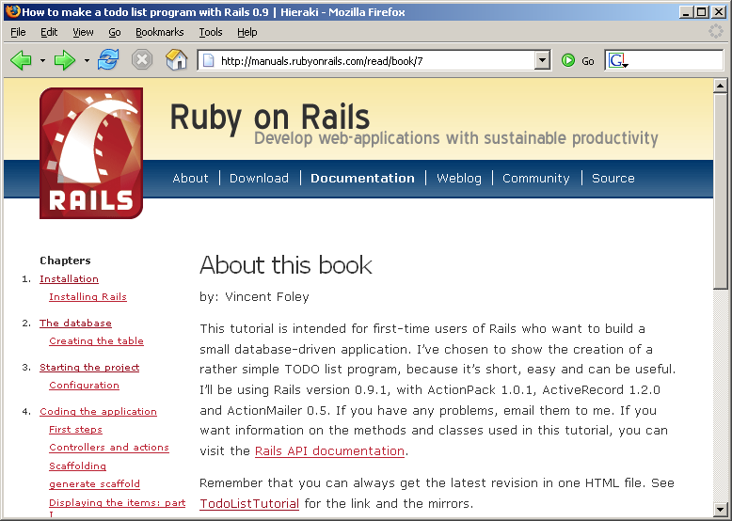
Demo
Todo List Tutorial Project
by Vincent Foley http://manuals.rubyonrails.com/read/book/7

Slide 15
Model – View – Controller
Model classes are the "smart" domain objects (such as Account, Product, Person, Post) that hold business logic and know how to persist themselves to a database
Views are HTML templates
Controllers handle incoming requests (such as Save New Account, Update Product, Show Post) by manipulating the model and directing data to the view

Slide 16
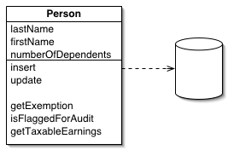
Model Classes
Based on Martin Fowler’s ActiveRecord pattern
  From Patterns of Enterprise Architecture
  An object that wraps a row in a database table or view, encapsulates the database access, and adds domain logic on that data.

Slide 17
ActiveRecord
Convention over Configuration (Applies to all of Rails)
No XML files!
Lots of reflection and run-time extension
Magic is not inherently a bad word
Admit the Database
Lets you drop down to SQL for odd cases and performance
Doesn‘t attempt to duplicate or replace data definitions

Slide 18
ActiveRecord API
Object/Relational Mapping Framework
Automatic mapping between columns and class attributes
Declarative configuration via macros
Dynamic finders
Associations, Aggregations, Tree and List Behaviors
Locking
Lifecycle Callbacks
Single-table inheritance supported
Eager fetching supported
Validation rules
More…

Slide 19
ActiveRecord Aggregations
Aggregation expresses a composed of relationship
Define value objects by using composed_of method
  Tells Rails how value objects are created from the attributes of the entity object when the entity is initialized and…
  how it can be turned back into attributes when the entity is saved to the database
  Adds a reader and writer method for manipulating a value object
Value objects should be immutable and that requirement is enforced by Active Record by freezing any object assigned as a value object.
Attempting to change value objects result in a TypeError

Slide 20
ActiveRecord Models are Multi-talented actors
The ActiveRecord::Acts module has super cool features that enhance your models behavior
acts_as_list
  Provides the capabilities for sorting and reordering a number of objects in list
acts_as_tree
  Model a tree structure by providing a parent association and a children association
acts_as_nested_set
  Similiar to Tree, but with the added feature that you can select the children and all of it’s descendants with a single query!

Slide 21
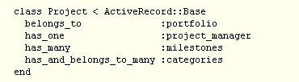
ActiveRecord Associations
Macro-like class methods for tying objects together through foreign keys
  Each adds a number of methods to the class
  Works much the same way as Ruby’s own attr* methods

Slide 22
ActiveRecord Timestamps
Magic timestamps!
  ActiveRecord objects will automatically record creation and/or update timestamps of database objects if columns with the names created_at / created_on or updated_at / updated_on are present in your db table

Slide 23
ActiveRecord Transactions
Simple declarative transaction support on both object and database level
# Just database transaction
Account.transaction do
david.withdrawal(100)
mary.deposit(100)
end
# Object transaction
Account.transaction(david, mary) do
david.withdrawal(100)
mary.deposit(100)
end

Slide 24
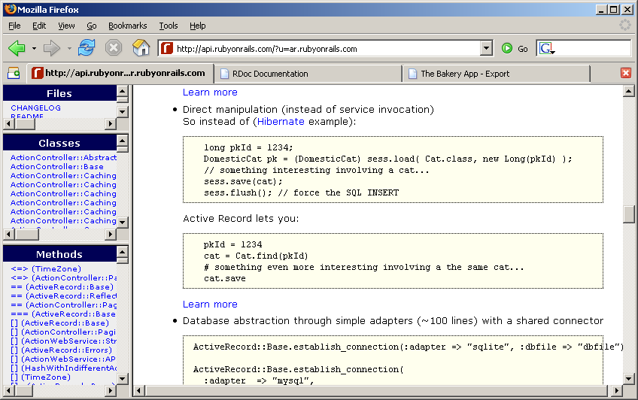
ActiveRecord vs Hibernate
Instead of
ActiveRecord lets you do

Slide 25
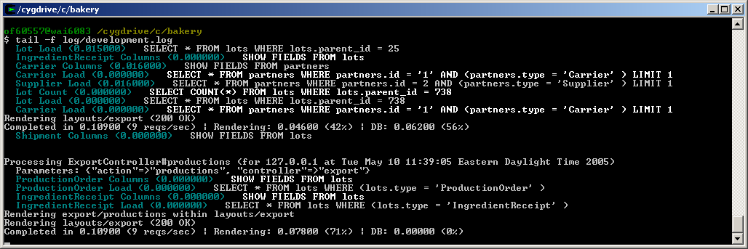
Rails Logging

Slide 26
ActionController API
Controllers defined as classes that execute and then either render a template or redirects
An action is a public method on the controller
Getting data in and out of controllers
Request parameters available in the @params hash (and can be multidimensional)
Web session exposed as @session hash
Cookies exposed as @cookies hash
Redirect scope provided by @flash hash (unique to Rails)

Slide 27
Filters and Request Interception
The simple way to add Pre and Post processing to actions
Access to the request, response, and instance variables set by other filters or the action
Controller inheritance hierarchies share filters downwards, but subclasses can also add new filters
Target specific actions with :only and :except options
Flexible Filter definition
  method reference (by symbol)
  external class
  inline method (proc)

Slide 28
From Controller to View
Rails gives you many rendering options…
Default template rendering – follow naming conventions and magic happens
Explicitly render to particular action
Redirect to another action
Render a string response (or no response)

Slide 29
View Template Approaches
ERB – Embedded Ruby
  Similar to JSPs <% and <%= syntax
  Easy to learn and teach to designers
  Execute in scope of controller
  Denoted with .rhtml extension
XmlMarkup – Programmatic View Construction
  Great for writing xhtml and xml content
  Denoted with .rxml extension
  Embeddable in ERB templates

Slide 30
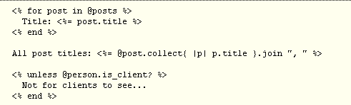
ERB Example

Slide 31
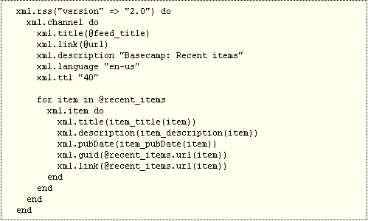
XmlMarkup Example

Slide 32
Similar to JSP is a Good Thing?
Aren’t Rails programmers going to be tempted to put a bunch of application logic in the templates?
The short answer is no.
JSPs are a less painful way to add logic to a screen. Due to the lower pain associated with their use, it is very tempting to add inappropriate code to them
That’s simply not the case with Rails!
Ruby is an excellent language for view logic (succinct, readable) and Rails is also made out of all Ruby. So there's no longing for a better suited template language and there's no pain relief in misappropriating business logic into the view.
- David H. Hansson

Slide 33
Layouts and Partials
Templates in app/views/layouts/ with the same name as a controller will be automatically set as that controller’s layout unless explicitly told otherwise
Partials are sub-templates that render a single object
  Partial template files follow convention
  Easy API support for rendering collections of partials.

Slide 34
Built-in Caching
Enhance performance by keeping the result of calculations, renderings, and database calls around for subsequent requests
Action Controller offers 3 levels of granularity
  Page
  Action
  Fragment
Sweepers are responsible for expiring caches when model objects change

Slide 35
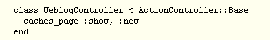
Page Caching
Entire action output of is stored as a HTML file that the web server can serve
As much as 100 times faster than going the process of dynamically generating the content
Only available to stateless pages where all visitors are treated the same
Easy to implement…

Slide 36
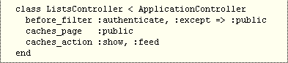
Action Caching
Entire output of the response is cached
Every request still goes to the controller
  filters are run before the cache is served
  allows for authentication and other restrictions on whether someone are supposed to see the cache

Slide 37
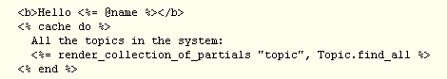
Fragment Caching
Caches parts of templates without caching the entire action
Use when elements of an action change frequently and other parts rarely change or are okay to share among requests
Four options for storage
  FileStore – Fragments shared on file system by all processes
  MemoryStore – Caches fragments in memory per process
  DrbStore – Fragments cached on a separate, shared process
  MemCachedStore – Uses Danga’s MemCached open source caching server

Slide 38
Pagination
Macro-style automatic fetching of your model for multiple views, or explicit fetching for single actions
  Included for all controllers
  Configure as much or as little as desired
  PaginationHelper module has methods for generating pagination links in your template

Slide 39
Helper Modules
Help you spend time writing meaningful code…
  ActiveRecordHelper
  AssetTagHelper
  DateHelper
  DebugHelper
  FormHelper(s)
  JavascriptHelper
  NumberHelper
  PaginationHelper
  TagHelper
  TextHelper
  UrlHelper

Slide 40
Helper Methods Examples
DateHelper::distance_of_time_in_words
  Reports the approximate distance in time between to Time objects. For example, if the distance is 47 minutes, it'll return "about 1 hour“
JavascriptHelper::link_to_remote
  AJAX in one line! Creates link to a remote action that’s called in the background using XMLHttpRequest. The result of that request can then be inserted into the browser’s DOM
JavascriptHelper::periodically_call_remote
  More AJAX! Links page to a remote action that’s called in the background using XMLHttpRequest. The result of that request can be inserted into the browser’s DOM
NumberHelper::human_size, number_to_currency, number_to_phone, etc…
  You get the picture!

Slide 41
The Quest for Pretty URLs
The responsibility of URL parsing is handled by Rails itself. Why?
  Not all webservers support rewriting
  Allows Rails to function “out of the box” on almost all webservers
  Facilitates definition of custom URLs
  Linked to URL helper methods such as url_for, link_to, and redirect_to
  Routing rules defined in config/routes.rb

Slide 42
routes.rb
ActionController::Routing::Routes.draw do |map|
# Priority based on creation: first created -> highest priority
# Keep in mind you can assign values other than :controller and :action
# You can have the root of your site routed by hooking up ''
# just remember to delete public/index.html.
map.connect '', :controller => "bakery"
map.connect 'query/:guid', :controller => “global", :action=>"query"
# Allow downloading Web Service WSDL as a file with an extension
map.connect ':controller/service.wsdl', :action => 'wsdl'
map.connect ':controller/:action/:id’ # Default
end

Slide 43
Rails to the Rescue
Actions that fail to perform as expected throw exceptions
  Exceptions can either be rescued…
  for public view (with a nice user-friendly explanation)
  for developers view (with tons of debugging information)
  By default, requests from localhost get developers view

Slide 44
ActiveSupport API
Rails utility methods
  Date conversion
  Number handling
  String conversions and inflection
  Time calculations

Slide 45
ActionMailer API
Rails’ built-in email service
  Write email controllers in same way as web controllers
  Integrated with templating system

Slide 46
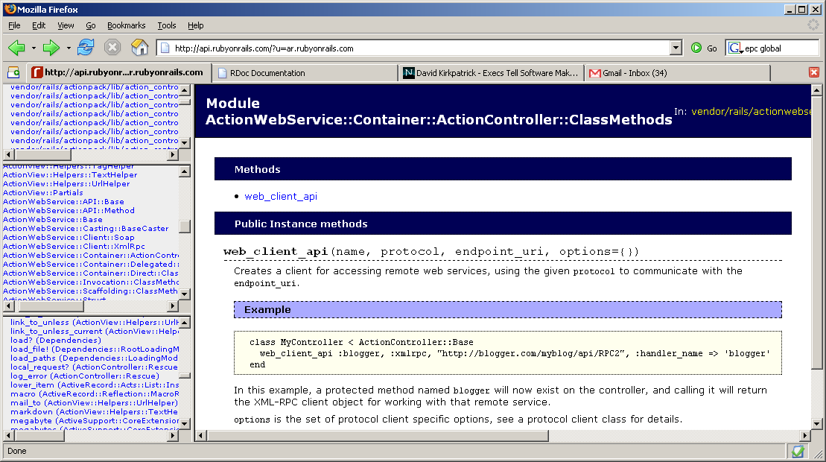
ActionWebService API
It’s easy to do web services in Rails
  Rails has built-in support for SOAP and XML-RPC
  Struct base class can be used to represent structured types that don’t have ActiveRecord implementations or to avoid exposing an entire model to callers
  Examples
  Define a web services client in one line
  Add a web service to a controller (next slide)

Slide 47
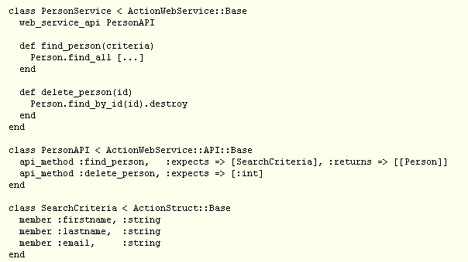
Defining a WebService

Slide 48
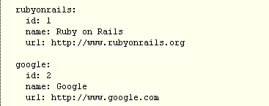
Fixtures
Use YAML sample data for testing
  Each YAML fixture (ie. record) is given a name and is followed by an indented list of key/value pairs in the "key: value" format.
  Records are separated by a blank line

Slide 49
Unit Testing
Rails includes Ruby’s test/unit
Rake pre-configured to run test suite or individual tests
Easy to load fixtures into a test case

Slide 50
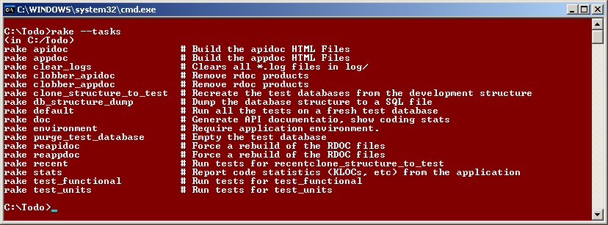
Rake
Ruby’s Build System
Familiar to Ant users
Your build file is a written in Ruby
Basic build script provided with Rails project

Slide 51
Rails Success Story
Basecamp (info as of late April ’05)
  Average lines of code for an action in Basecamp is 5
  Written in 9 months
  Tens of thousands of users
  300k dynamic page renders/day
  Hosted on two app servers with 15 fastcgi processes each + one MySQL server

Slide 52
The Rails Community
The developer community around Rails is very helpful and excited
  Rails Wiki - http://wiki.rubyonrails.com/
  Rails Mailing List – very active
  IRC – Get instant answers to most questions. David and other Rails commiters are all regularly present

